Slide 1
2 Peter 1:1-4

Slide 2
Growing in Holiness
in Light of the Promised Blessed Hope of the Lord and Savior’s Soon Return

Slide 3
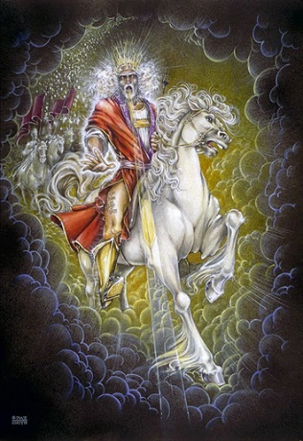
Growing in Holiness
2 PETER
The Blessed Hope is the certainty that our God and Savior Jesus Christ is retuning soon, just as He promised before the Day of the Lord, and when it does the world is going to burn. (3:10). In light of this Peter tells us how we should then live.
Notes:
The message of Second Peter is about hope.
Instead of putting our hope in the world and ever investing in the things of this world, Peter tells us to put our hope in Christ. Instead of being misled by false promises of fame and glory in this world, we ought to live in the expectation of the prophetic promises of Jesus’ soon return to establish His glorious kingdom on earth until the conclusion of all things, and then at that time He will create an new heaven and new earth in which only righteousness will exists.
The more we are rooted in this promise and hope, the more we ought to live in holiness, adding good moral conduct to our faith, persevering in the midst of personal trials, and developing our Christian character all in the expectation of being rewarded with a rich entrance to Jesus’ future kingdom.

Slide 4
Growing in Holiness
2 PETER
Outline

Slide 5
Growing in Holiness
2 PETER
Salutation: Greeting and Blessing – 1:1-2
Prologue: The Basis and Basics of Holiness – 1:3-11
Purpose: To Establish Them in the Truth – 1:12-15
Body: Hold Fast the Hope of Christ’s Coming
– 1:16 – 3:13
Epilogue: Parting Thoughts – 3:13-14

Slide 6
Growing in Holiness
2 PETER
Prologue: [Introduction] – 1:3-11
The Basis of Holiness – 1:3-4
The Provisions for Holiness – 1:3
His Divine Power – 1:3
His Divine Promises – 1:4a
The Partakers in Holiness – 1:4b

Slide 7
Growing in Holiness
2 PETER
Prologue: [Introduction] – 1:3-11
The Basics of Holiness – 1:5-11
The Characteristics of Holiness – 1:5-7
The Consequences of Holiness – 1:8-9
The Conclusiveness of Holiness – 1:10-11

Slide 8
Growing in Holiness
2 PETER
Purpose: To Establish them in the Truth in which
they Stand, Taught by a Present and
Future Reminder – 1:12-15

Slide 9
Growing in Holiness
2 PETER
Body: Hold Fast to the Hope of Christ’s Coming
– 1:16 – 3:13
The Hope of Christ’s Coming is a Certainty – 1:16-21
The Hope of Christ’s Coming will Encounter Opposition – 2:1 – 3:9

Slide 10
Growing in Holiness
2 PETER
The Hope of Christ’s Coming will Encounter Opposition – 2:1 – 3:9
The Coming of False Teachers – 2:1-3
The Doom of False Teachers – 2:4-9
The Character of False Teachers – 2:10-17
The Victims of False Teachers – 2:18-21
The Doctrine of False Teachers – 3:1-9

Slide 11
Growing in Holiness
2 PETER
Body: Hold Fast to the Hope of Christ’s Coming
– 1:16 – 3:13
The Hope of Christ’s Coming is a Certainty – 1:16-21
The Hope of Christ’s Coming will Encounter Opposition – 2:1 – 3:9
The Hope of Christ’s Coming will Culminate in the Day of the Lord – 3:10-13

Slide 12
Growing in Holiness
2 PETER
Key Verse:
“Therefore, since all these things will be dissolved, what manner of persons ought you to be in holy conduct and godliness”
(2 Peter 3:11)

Slide 13
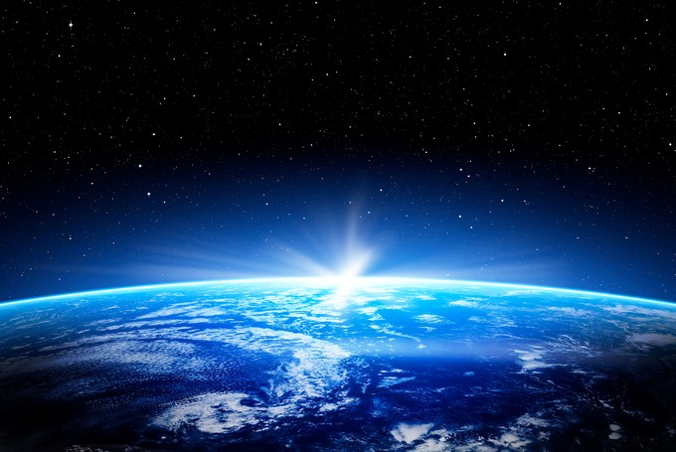
Growing in Holiness
2 PETER
A Verse of Hope:
“Nevertheless we, according to His promise, look for new heavens and a new earth in which righteousness dwell” (2 Peter 3:13)

Slide 14
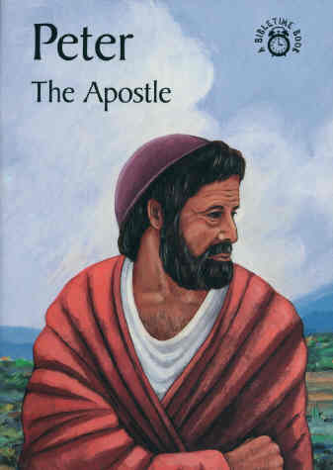
Growing in Holiness
2 PETER
The Salutation – 1:1-2
The Greeting – 1:1
“Simon Peter”
The Author
Notes:
Peter using the name “Simon Peter”. He may possibly combining these distinctly Hebrew and Jewish name as an indication of the mixed audience of Jews and Gentiles.

Slide 15
Growing in Holiness
2 PETER
The Salutation – 1:1-2
The Greeting – 1:1
“Simon Peter, a bondservant and apostle of Jesus Christ,” (1:1a)
The Author
Notes:
In the first letter Peter simply calls himself an apostle of Jesus Christ, but here he also describes himself as a “bondservant”, in sharp contrast with the arrogant and disobedient false teachers who will even deny “the Lord of bought them”. He is first Christ’s servant and His apostle second.

Slide 16
Growing in Holiness
2 PETER
The Salutation – 1:1-2
The Greeting – 1:1
“Simon Peter authorship called into question?
The Author
Notes:
Reasons

Slide 17
Growing in Holiness
2 PETER
Reasons for Questioning Peter’s Authorship
Not referred to by any early church fathers.
Early acceptance was slow due to fake letters by fake apostles.
Some questioned it because of stylistic differences.
The Author
Notes:
Not referred to by any early church fathers of the second century – Silence does not argue for or against Petrine authorship. The letter is short and was probably not widely circulated at first.
In the third century 2 Peter was referred to by several prominent church fathers. By the fourth century the Petrine authorship was strongly affirmed. Both Athanasius and Augustine considered 2 Peter as canonical. Jerome place it in the Latin Vulgate. And the third Council of Carthage recognized the intrinsic authority and worth of 2 Peter.
Its acceptance may have come slowly because of suspicion of other letters in the early church bearing the name by the apostles. Forgeries were fairly common in the early church. Even Paul warned about forged letters (2 Thess. 2:2). [There are pseudonymous writings as the Apocalypse of Peter, the Gospel of Peter and the Acts of Peter that were rejected]. Also, the letter was written not long before his death and so he was not around to verify its authenticity.
Jerome first pointed out the stylistic differences, but explain the differences by the fact that Peter used a scribe [Silvanus] in the first letter and not in the second. The differences are plausibly explained by the fact that the two letter contain different subject matter and different purposes. There may be just as many stylistic similarities as there are differences.
The two books are filled with what is known as “hapax legomena”, words that occur only once in the NT. There are proportionately more of these words than most NT books their size. In fact Homer K. Ebright concluded that the noticeable differences are not between the two Petrine Epistles but between these Epistles and the rest of the NT. This may point to a common author who had a rich vocabulary and a public speaker’s flare for fresh creative expression. (BKC, p. 860)

Slide 18
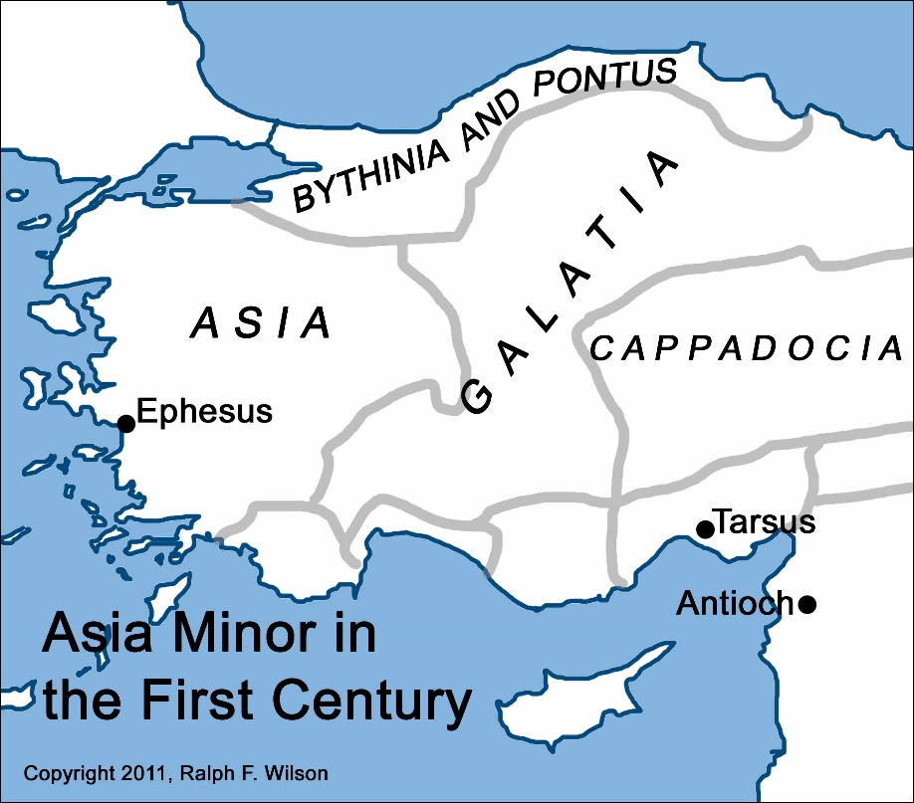
Growing in Holiness
2 PETER
The Salutation – 1:1-2
The Greeting – 1:1
“to the pilgrims of the dispersion in Pontus, Galatia, Cappadocia, Asia, and Bithynia…” (1 Peter 1:1b)
The Audience
Notes:
They were aliens and dispersed Jews and Gentiles living in a foreign land. The current evil world is not our permanent home. Our stay here is only for a little while.

Slide 19
Growing in Holiness
2 PETER
The Salutation – 1:1-2
The Greeting – 1:1
In the Lord, they were Chosen, Consecrated, Confirmed and Cleansed
(1 Peter 1:1b)
The Audience

Slide 20
Growing in Holiness
2 PETER
The Salutation – 1:1-2
The Greeting – 1:1
“To those who have obtained like precious faith with us by the righteousness of our God and Savior Jesus Christ:”
The Audience
Notes:
The recipients of the letter are only described in general terms.
“To those who have obtained” is all one word in Greek and Gangel calls this an unusual verb, “lanchano” – “to obtain by lot” or by the will of God.
Many Calvinist believe that this is faith that is given to the believer in order that he may believe and be saved, saving faith is a gift of God, they say. The unbeliever must be given this faith since he has no ability at all to do so because he is dead in sin, unable to do anything – “totally inability”.
However, “faith” has no article which more likely means the subjective ability to believe. In other words, God does not give us the faith to believe, but He does give us, mankind that is, the ability to believe. If someone chooses not to believe it was not because he was not able, he could not, it was because he was not willing. If someone believes, he did so because he had not only possessed the ability to do so, he could believe, but also because he was willing to do so as well.
This faith is also “precious” or “of equal value”. The readers faith was every bit as much of value for them as it had been for the Apostles who were eyewitnesses of its reality. Its worth was not diminished by the fact that they themselves had not seen what the Apostles had seen, heard and touched.
“Their faith had obtained them a righteous standing before God (justification) and it also directed them toward righteous living. The full value of the faith could only be realized in one sphere, namely, the sphere of divine righteousness, both imputed (credited by faith alone), and experiential (lived out in their lives). As the epistle unfolds, it is clear that the false teachers threaten the readers’ experience of righteousness.” (Hodges, p. 16) The false teachers could not threated their imputed righteousness which belongs to them forever as a result of an irrevocable free gift from God received by faith alone.
The grammar here clearly indicates that “God and Savior” are one Person, not two. This passages ranks as one of the great Christological passages of the NT which plainly teaches that Jesus is coequal in nature with God the Father.

Slide 21
Growing in Holiness
2 PETER
The Salutation – 1:1-2
The Blessing – 1:2
“Grace and peace be multiplied to you in the knowledge of God and of Jesus our Lord.”
Growth
Notes:
There is a lot of mathematics in second Peter. He uses multiplication, which is magnified growth. In verse 5 of chapter one he going to say by giving all diligence that we can add to our faith. But failing to do so will result in subtraction, “the latter end is worse (morally) for them than the beginning.” (2:20) And the false teachers caused division.
Peter’s desire is that the readers might discover how God can multiply their experiences of His grace and peace. They already possessed grace and peace by faith, but who wants more?
“Grace and peace” is multiplied in the “knowledge” – “epignosei”, “additional or full knowledge of God, which implies a more intimate and personal relationship. Believers are urged to take advantage of the “full knowledge” available to them in Christ Jesus. The false teachers claimed to have special knowledge, usually obtained through some eccentric experience, visions and dreams delivered sometimes by angels.
This additional grace and peace though is only “in the knowledge of God and of Jesus our Lord.” Only as believers stay rooted in their knowledge of God and His Son and allow that knowledge to determine the direction of their lives—only by this will they truly experience, ever more abundantly God’s grace and peace. Failing to do so and being fooled by the false teachers will only lead into a quagmire of sin, the swamp.
Peter, a faithful shepherd of Christ’s flock, is writing so as to warn his fellow believers of the coming of false teachers who will lead them into the swamp.

Slide 22
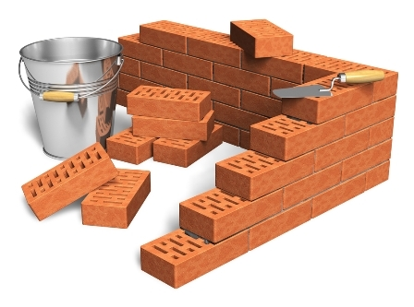
Growing in Holiness
2 PETER
The Prologue of the Letter – 1:3-11
The Basis of Holiness – 1:3-4
Notes:
Verses 3 and 4 is one sentence. The elaborate structure is intended to introduce the epistles’ prologue [Introduction], and is connected to verse 5-9.
“As (or since) His divine power has given to us…” (vv. 3-4)
“But also (or, and indeed) for this very reason… add to your faith.”
God’s gracious provision for us (3-4) is the foundational reason why we should follow through and add to our faith.

Slide 23
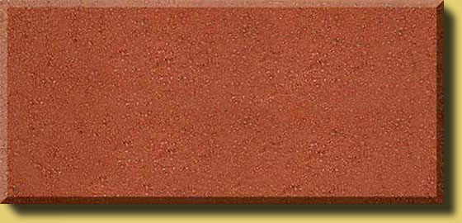
Growing in Holiness
2 PETER
The Prologue of the Letter – 1:3-11
The Provision for Holiness – 1:3-4a
“His divine power has given to us all things that pertain to life and godliness, through the knowledge of Him who called us by glory and virtue,” (1:3)
POWER

Slide 24
Growing in Holiness
2 PETER
The Prologue of the Letter – 1:3-11
The Provision for Holiness – 1:3-4a
“by which have been given to us exceedingly great and precious promises,” (1:4a)
POWER
PROMISE

Slide 25
Growing in Holiness
2 PETER
The Prologue of the Letter – 1:3-11
The Partakers of Holiness – 1:4b
“that through these you may be partakers of the divine nature, having escaped the corruption that is in the
world through lust.”
PARTAKE
POWER
PROMISE

Slide 26
Growing in Holiness
2 PETER
Conclusion
Notes:
Are you ready for the blessed hope? In light of the Lord and Saviors’ soon return and the gracious provisions He has provide are you ready to grow in holiness in the knowledge of great God and Savior, Jesus Christ? Are you ready to add good works to your faith? Not to obtain salvation, but to add to your salvation. If so, I’ll see you next week!

